Slide 1
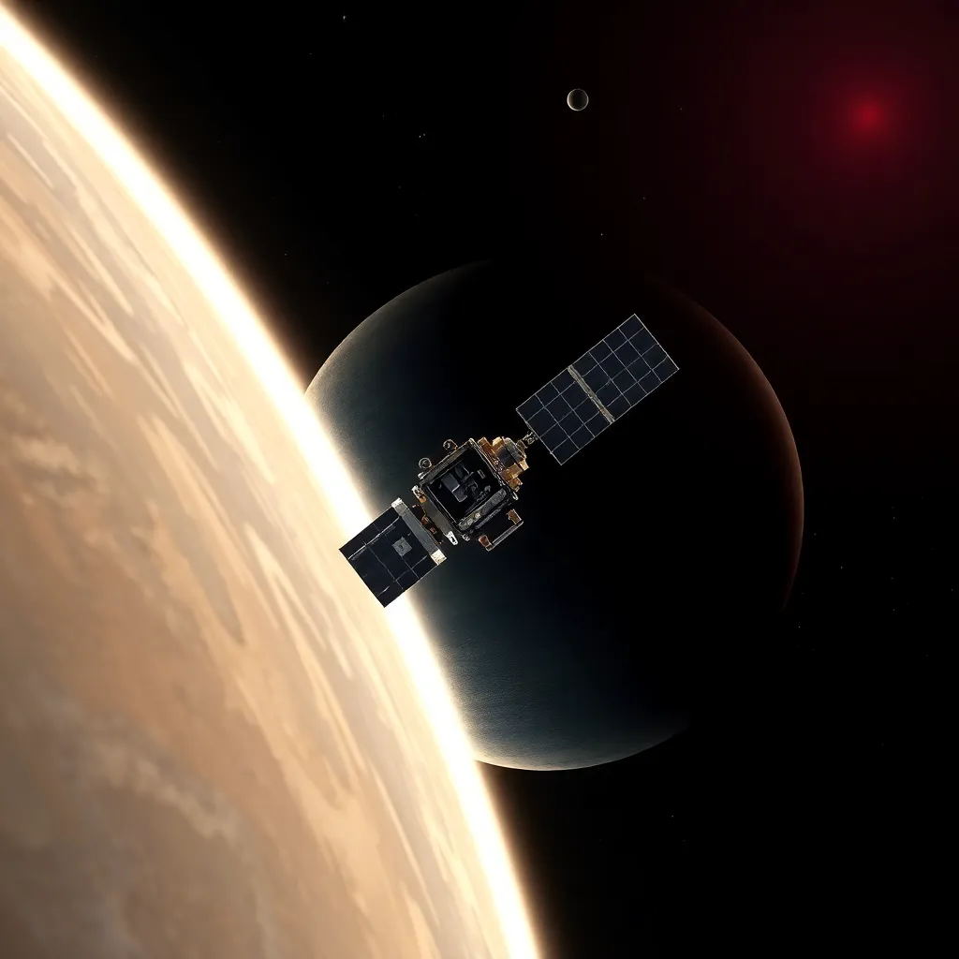
CubeSAT
"In Pursuit of Mystery: CubeSAT’s Journey to Venus"

Slide 2




SOME BASIC MISSION OBJECTIVES
Temperature Measurements
Atmospheric Composition
Analyze the composition of the Venusian atmosphere to better understand its formation and evolution.
Climate Dynamics
Study the complex climate patterns and atmospheric circulation.

Slide 3

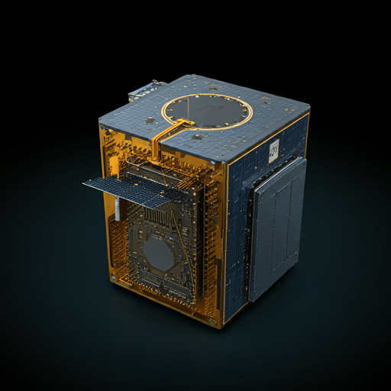


CubeSAT : A Closer Look
Modular Design for Assembly and Maintenance
Communication Subsystem
Sensor Subsystem
:
CubeSAT is designed with a modular layout, allowing easy assembly. Each module can be tested independently before full integration.
The modular approach facilitates maintenance, especially valuable for a complex mission like Venus exploration.
Power Subsystem

Slide 4

thermal subsystem To ensure that component temperature limits are not exceeded
attitude determination and control subsystem
For satellite position and orientation sensing and adjustment.
mechanisms and structures subsystem
For satellite cube, mountings and mechanisms for antenna and antenna deployment.
payload system
To collect and store voltage signals from the sensor.

Slide 5

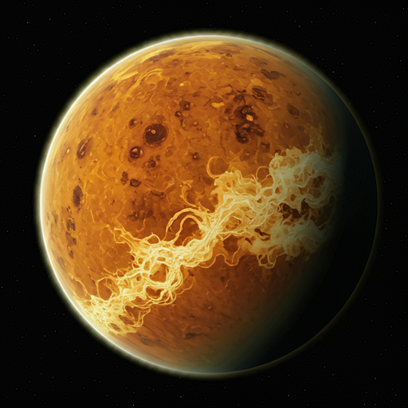

COMMUNICATION SUBSYSTEM
Atmospheric Interference:
Venus's Dense Atmosphere : The thick, carbon dioxide-rich atmosphere of Venus can significantly attenuate radio signals, particularly at higher frequencies.
Ionospheric Disturbances : The ionosphere, a layer of ionized gas in the upper atmosphere, can cause signal fading and distortion
Deep Space Communication Challenges:
Propagation Delay:The vast distance between Earth and Venus results in significant signal propagation delays, impacting real-time communication.
Doppler Shift:The relative motion between Earth and Venus causes a shift in the frequency of the transmitted signal, requiring precise frequency tracking.
Noise and Interference: Deep space is filled with various noise sources, such as cosmic radiation and interference from other spacecraft, which can degrade signal quality.

Slide 6

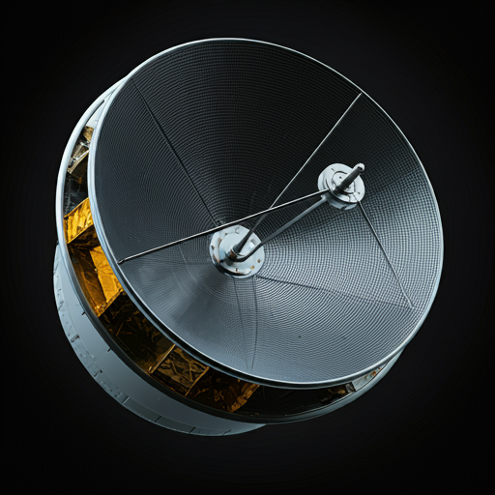
Solution: Antenna Design
Antenna Type :
High-Gain Antenna
Antenna Orientation :
Precise Pointing
Deployment Mechanism:
Additional Considerations:
Antenna Size and Weight
Power Consumption
Thermal Management

Slide 7

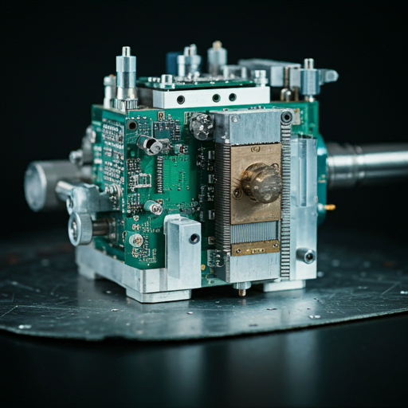
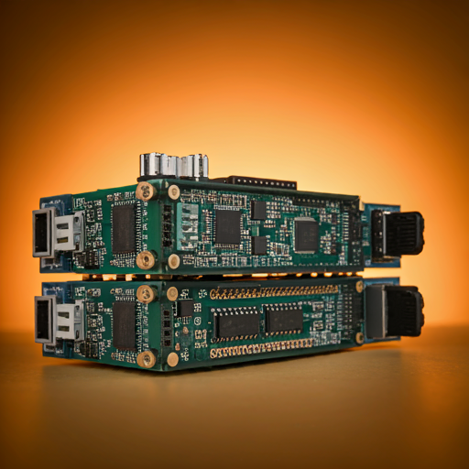
SENSOR SUBSYSTEM
Primary Sensor : Miniaturized Mass Spectrometer (MMS)
Challenges of Operating an MMS in the Venusian Environment
High Temperature and Pressure
Corrosive Atmosphere
Dust and Particles
To address these challenges, the MMS must be carefully designed and protected. This may involve using specialized materials, robust electronics, and advanced thermal management techniques. Additionally, the instrument may need to be calibrated frequently to ensure accurate measurements.
Temperature Sensor
Key Roles
Thermal Structure
Energy Balance
Climate Dynamics
Challenges and Considerations:
Extreme Temperatures
Thermal Radiation
Calibration

Slide 8
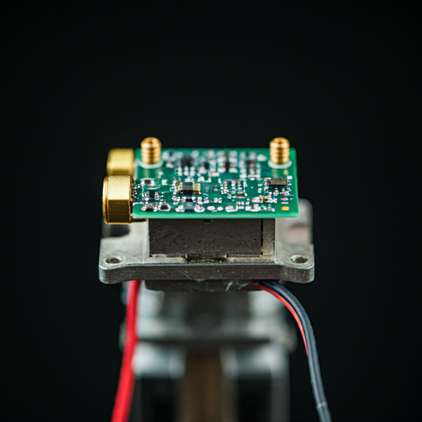
Pressure Sensor
Key Roles of a Pressure Sensor:
Vertical Structure
Atmospheric Dynamics
Climate Modeling
Challenges and Considerations:
Extreme Pressure
Temperature Extremes
Calibration
Addressing the Challenges
Extreme Pressure : Robust Sensor Design, Overpressure Relief.
Pre-launch Calibration, In-flight Calibration, Temperature Compensation
Thermal In Calibration: Thermal Insulation, Heat-Resistant Materials, Active Cooling

Slide 9
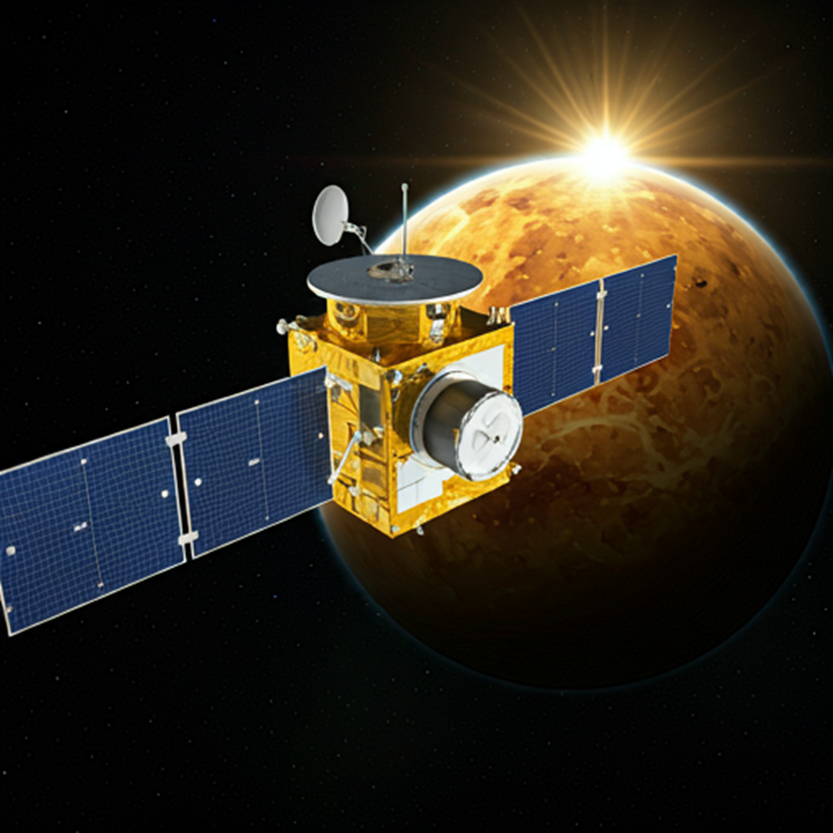
POWER SUBSYSTEM
Distributes power to various subsystems based on their requirements.
Includes power switches, fuses, and circuit breakers for protection.
Key Components:
Solar Panels:
High-efficiency solar cells to convert sunlight into electrical energy.
Deployment mechanism to orient the panels towards the Sun.
Thermal management system to prevent overheating.
Batteries:
High-energy-density batteries to store excess energy for nighttime operations.
Thermal management to maintain optimal operating temperature.
Power Conditioning Unit (PCU)
Distributes power to various subsystems based on their requirements.
Includes power switches, fuses, and circuit breakers for protection.
Power Conditioning Unit (PCU)
Regulates the voltage and current from the solar panels.
Converts DC voltage to the appropriate levels for different subsystems.

Slide 10
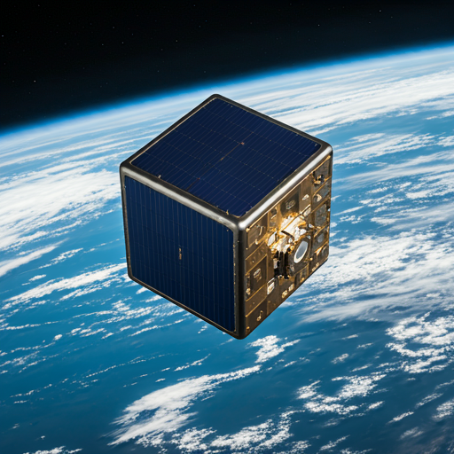
Challenges and Solutions
:
Extreme Temperatures:
Thermal Insulation: To protect components from excessive heat.
Heat Sinks and Radiators: To dissipate heat.
Temperature-Controlled Enclosures: To maintain optimal operating temperatures.
Limited Solar Energy:
High-Efficiency Solar Cells: To maximize energy generation.
Optimal Panel Orientation: To ensure maximum sunlight exposure.
Energy Storage: To store excess energy for nighttime operations.
Power Consumption:
Power-Efficient Components: To minimize power consumption.
Power-Saving Modes: To reduce energy usage during inactive periods.
Intelligent Power Management: To optimize power distribution.

Slide 11
MODES ALONG THE MISSION
Launch sequence – This is a one time “sequence” preformed after launch. Once this sequence is performed the satellite will only operate in one of the four modes of operation (safe, idle, normal, and transmit).
Safe mode – Command & Data Handling system is on and ready to go into idle mode. Perform basic tasks, such as battery charging, checking vital housekeeping.
Idle mode – Only housekeeping electronics are on. Command & Data Handling system is storing housekeeping information. Batteries will also be charging if need be. Check transmitting beacon.
Normal mode – Science experiment running, Command & Data Handling system will be storing data from experiment. Command & Data Handling system is collecting housekeeping data. Battery charging. Transmitting beacon.
Transmit mode – retrieve and transmit stored data, transmitting beacon, upload data (transmitter shutdown, etc).

Slide 12

SOME OPERATIONS
Remove before flight pins removed, power remains off
Kill switches released
Batteries begin charging
Secondary receiver is always on
Microprocessor supervisory circuit applies power to MCU
Secondary microcontroller enters a low power stand-by state
Primary microcontroller enters normal power mode
Primary MCU starts boot sequence
Starts counter, incrementing (oscillator, need flight qualification)
General health check, temperature batteries, voltage of batteries
Wait for batteries to exceed threshold
Antenna Deployment
Deploy secondary receiver antenna, confirm deployment
Health check
Deploy primary receiver antenna, confirm deployment. When antenna deployed, physically overwrite flag in program memory (or use goto command) to never repeat the flight sequence (may want to add command for try to deploy antennae)
Exit the launch sequence
Enter into Safe mode and start normal mode cycle.

Slide 13
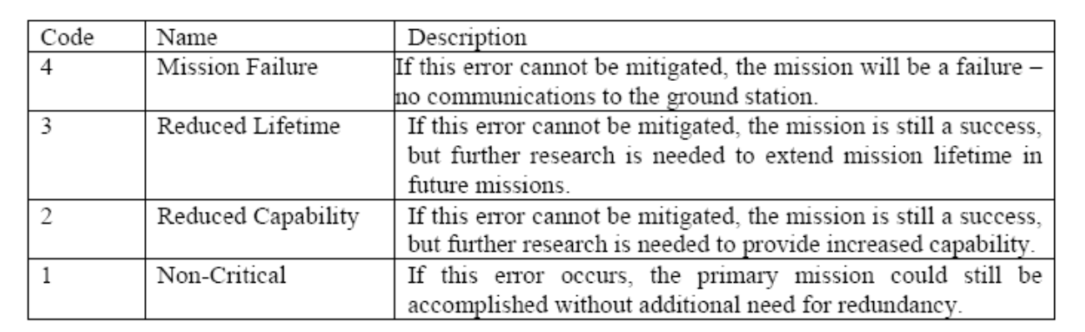
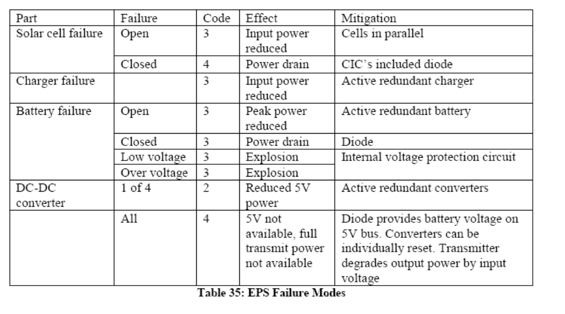
FAILURE MODE ANALYSIS

Slide 14

Data From Other Projects
Payload
GaN based UV sensor
C&DH (Command and Data Handling)
Redundant Atmel ATmega2561 Microcontroller
I2C, SPI, & USART serial bus protocols (peripherals)
32MB Atmel external serial flash memory
Dual-coil latching relay power control
COMM (Communications)
1) 435 – 438 MHz uplink/downlink,2) 1200 baud FM modulation, 3) Yaesu VX-2R 2 W Transceiver,4) \TNC-X ,5) 2 Half Wave Dipole Antenna
EPS (Electrical Power System)
1) 4 – 6 strings of 2 each series 26.8% efficient ITJ Spectrolab CICs, 2) 1.8W input from solar cells, single side, 3) MAX1879 MPPT/Battery charging chip, 4) Two rechargeable Ultralife 1.7Ah, 3.7 V Li-Ion batteries.
ACD (Attitude & Control Determination)
1) Control: Alinco Cast 5 permanent magnets & Hysteresis dampening, 2) Determination: Solar cells used as cosine detectors
Structures and Mechanisms
~150mm x 150mm x 150mm “cube” shell, created with hard-anodized Al 7075 T6, less than 1kg total mass, including support for PCB boards and all internal components.
Ground Station

Slide 15

Thanks!
CREDITS for images used :IMAGEN 3 DALL-E
WARREN SEQUEIRA cs24bt047@iitdh.ac.in

